Slide 1
Process & Thread
Nguyen Duc Kien
Hung Tran

Slide 2
Outline
Process Management
Interupts
Thread In Operating System
Types of Thread
Multi-Thread Models
Process Synchronization

Slide 3
Process Management
1

Slide 4
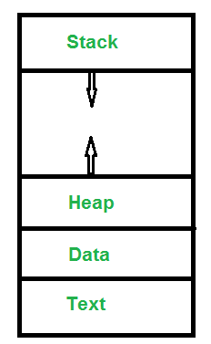
Program vs Process
A process is a program in execution.
A single program can create many processes when run multiple times.
Process in memory:
Text Section: A Process, sometimes known as the Text Section, also includes the current activity represented by the value of the Program Counter.
Data Section: Contains the global variable.
Stack: The stack contains the temporary data, such as function parameters, returns addresses, and local variables.
Heap Section: Dynamically allocated memory to process during its run time.
Notes:
Program vs Process: For example, when we write a program in C or C++ and compile it, the compiler creates binary code. The original code and binary code are both programs. When we actually run the binary code, it becomes a process.

Slide 5
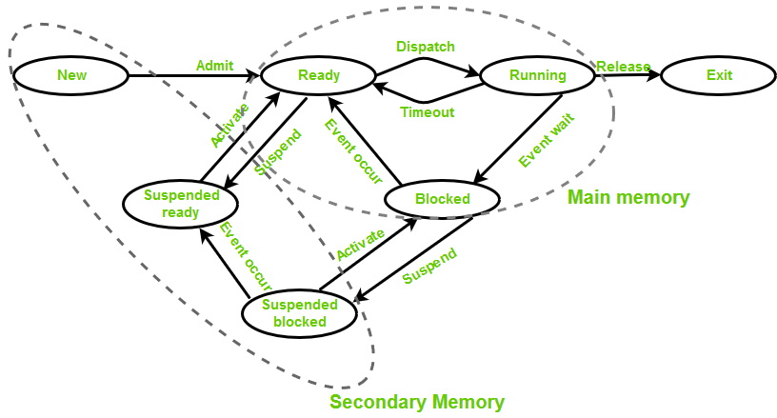
State Of A Process In Operating System
New (Create): is the program which is present in secondary memory that will be picked up by OS to create the process.
Ready: After the creation of a process, the process enters the ready state. It’s waiting to get the CPU time for its execution in a queue of ready processes.
Run: The process is chosen by CPU for execution and its instructions are executed by any available CPU cores.
Exit (Terminate): Process is killed as well as PCB (Process Control Block) is deleted.
Blocked (wait): Whenever the process need requests access to I/O, or input from user or need access to critical region.
Suspend ready: Process that was initially in the ready state but were swapped out of main memory because of priority message come when main memory is full.
Suspend blocked: Similar to suspend ready.
Second memory which can not be accessed directly by CPU (hard drives, solid state drives, USB flash drivers, CDs).
Primary memory which can be accessed directly by CPU (cache, system ROM). But usually, it refer to RAM.

Slide 6
Process Schedulers
There are 3 types of process scheduler:
Long Term (job scheduler): It brings the new process to the ‘Ready State’, i.e., it controls number of process present in ready state at any point of time. It is important that the long-term scheduler make a careful selection of both IO and CPU bound process.
Short term (CPU scheduler): is responsible for selecting one process from ready state for scheduling it on the running state. Dispatcher is responsible for loading the process selected by Short-term scheduler on the CPU. A dispatcher does the following:
Switching context.
Switching to user mode.
Jumping to the proper location in the newly loaded program.
Medium-term scheduler: is responsible for suspending and resuming the process.
Notes:
Sửa lại ảnh

Slide 7
Process Table and Process Control Block (PCB)
As the operating system supports multi-programming, it needs to keep track of all the processes. For this task, the process control block (PCB) is used to track the process’s execution status.
When the process makes a transition from one state to another, the operating system must update information into the PCB.
The process table is an array of PCB, that means logically contains a PCB for all of the current processes in the system.
Notes:
Sửa lại ảnh

Slide 8
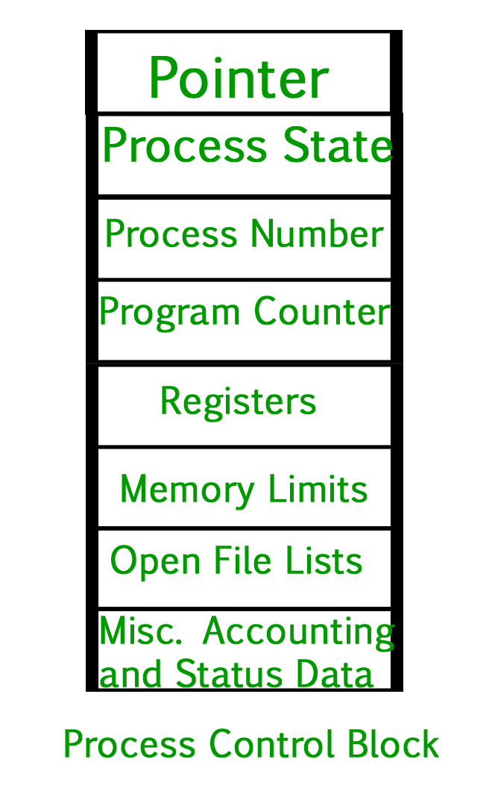
Pointer – It is a stack pointer which is required to be saved when the process is switched from one state to another to retain the current position of the process.
Process state – It stores the respective state of the process.
Process number – Every process is assigned with an unique id known as process ID or PID.
Program counter – It stores the counter which contains the address of the next instruction that is to be executed for the process.
Register – These are the CPU registers which includes: accumulator, base, registers and general purpose registers.
Memory limits – This field contains the information about memory management system used by operating system. This may include the page tables, segment tables etc.
Open files list – This information includes the list of files opened for a process.
Notes:
Sửa lại ảnh

Slide 9
Interupts
2

Slide 10
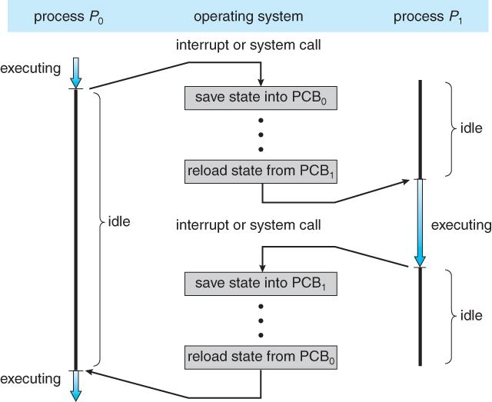
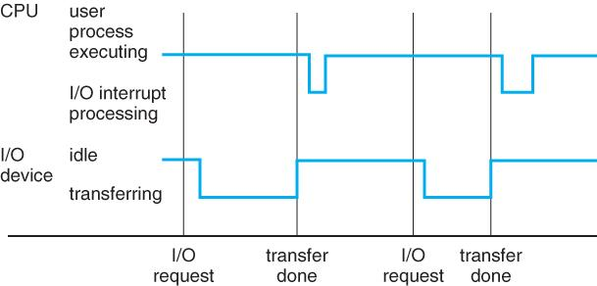
Interrupt is a signal emitted by hardware or software when a process or an event needs immediate attention.
It alerts the processor that a high-priority process requiring interruption of the current working process. In I/O devices, one of the bus control lines is dedicated for this purpose and is called the Interrupt Service Routine (ISR).
Notes:
Sửa lại ảnh

Slide 11
State of process when interrupt occur
Assume a device raises an interrupt at process i, the processor first completes the execution of instruction i.
The address of the interrupted instruction is moved to a temporary location.
Loading the Program Counter (PC) with the address of the first instruction of the ISR.
After handling the interrupt the processor can continue with process i+1.
Notes:
While the processor is handling the interrupts, it must inform the device that its request has been recognized so that it stops sending the interrupt request signal. Also, saving the registers so that the interrupted process can be restored in the future, increases the delay between the time an interrupt is received and the start of the execution of the ISR. This is called Interrupt Latency.

Slide 12
Thread In Operating System
3

Slide 13
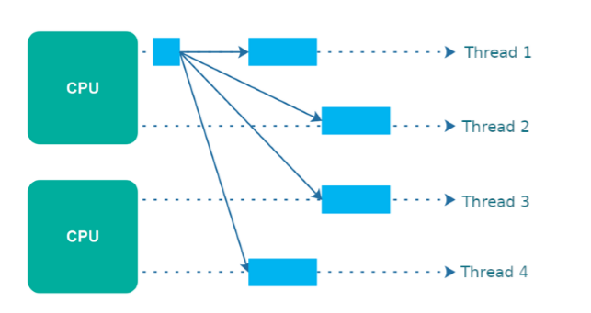
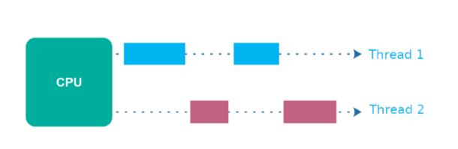
Concurrency and Parallelism
Concurrency is making progress on more than one task - seemingly at the same time.
Parallelism is splitting a single task into subtasks which can be executed in parallel.
Concurrency
Parallelism
Notes:
Sửa lại ảnh

Slide 14
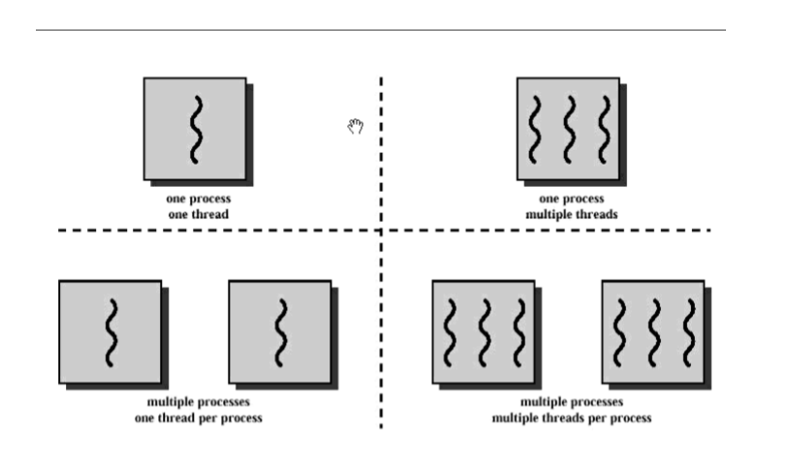
Relationship and different between Thread and Process
A thread is a path of execution within a process. A process can contain multiple threads.
A thread is also known as lightweight process. Its idea to achieve parallelism by dividing a process into multiple threads. -> For example: in a browser, multiple tabs can be different threads.
The primary difference is that threads within the same process run in a shared memory space, while processes run in separate memory spaces.
Threads are dependent of one another but processes are not, because threads share with other threads their code section, data section, and OS resources. So, to solve this problem, we need data synchronization
Similar between Threads vs Processes:
Only one thread or process is active at a time
In a processor, both execute sequential
Both can create children
Notes:
Sửa lại ảnh

Slide 15
Table different between Process and Thread
S.NO | Process | Thread
1. | Process means any program is in execution. | Thread means segment of a process.
2. | Process takes more time to terminate. | Thread takes less time to terminate.
3. | It takes more time for creation. | It takes less time for creation.
4. | It also takes more time for context switching. | It takes less time for context switching.
5. | Process is less efficient in term of communication. | Thread is more efficient in term of communication.
6. | Process consume more resources. | Thread consume less resources.
7. | Process is isolated. | Threads share memory.
8. | Process is called heavy weight process. | Thread is called light weight process.
9. | Process switching uses interface in operating system. | Thread switching does not require to call a operating system and cause an interrupt to the kernel.
10. | If one process is blocked then it will not effect the execution of other process | Second thread in the same task could not run, while one server thread is blocked.
11. | Process has its own Process Control Block, Stack and Address Space. | Thread has Parents’ PCB, its own Thread Control Block and Stack and common Address space.
Notes:
Sửa lại ảnh

Slide 16
Types of Thread
4

Slide 17
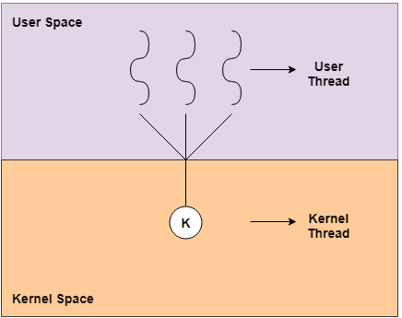
User Level thread (ULT)
The user-level threads are implemented by users and the kernel is not aware of the existence of these threads. The kernel only handle user-level threads when they are single-threated processes (only main function).
Advantages of User-Level Threads:
User-level threads are easier and faster to create than kernel-level threads. They can also be more easily managed.
User-level threads can be run on any operating system.
There are no kernel mode privileges required for thread switching in user-level threads.
Disadvantages of User-Level Threads:
Multithreaded applications in user-level threads cannot use multiprocessing (parallelism) to their advantage.
The entire process is blocked if one user-level thread performs blocking operation.

Slide 18
Kernel-Level Threads
Kernel-level threads are handled by the operating system directly and the thread management is done by the kernel.
Advantages of Kernel-level threads:
Multiple threads of the same process can be scheduled on different processors in kernel-level threads.
If a kernel-level thread is blocked, another thread of the same process can be scheduled by the kernel.
Disadvantages of Kernel-level threads:
Slow and inefficient.
It requires thread control block so it is an overhead.
!Note: Thread Control Block (TCB) is a data structure in the operating system kernel which contains thread-specific information needed to manage it. It comprise:
Thread ID: Identify the thread
Program counter (PC): keeps track of which instruction to execute next.
System registers: current working variables.
A stack: contains the execution history

Slide 19
Table different between User-level threads and Kernel-level threads
User level thread | Kernel level thread
User thread are implemented by users. | Kernel threads are implemented by OS.
OS doesn’t recognized user level threads. | Kernel threads are recognized by OS.
Implementation of User threads is easy. | Implementation of Kernel thread is complicated.
Context switch time is less. | Context switch time is more.
Context switch requires no hardware support. | Hardware support is needed.
If one user level thread perform blocking operation then entire process will be blocked. | If one kernel thread perform blocking operation then another thread can continue execution.
User level threads are designed as dependent threads. | Kernel level threads are designed as independent threads.

Slide 20
Multi-Threads Models
5

Slide 21
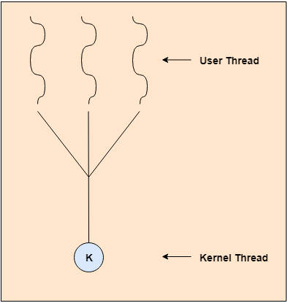
Many to one model
The many to one model maps many of the user threads to a single kernel thread.
This model is quite efficient because thread management is done by the thread’s library in user space.
Disadvantages of many-to-one model:
Multithreaded applications in user-level threads cannot use multiprocessing (parallelism) to their advantage.
The entire process is blocked if one user-level thread performs blocking operation.

Slide 22
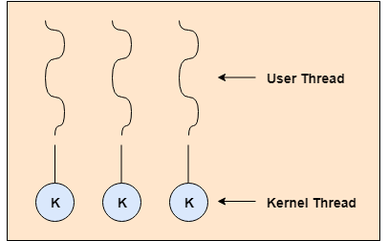
Many to one model
The one to one model maps each of the user threads to a kernel thread.
Allow many threads can run in parallel on multiprocessors
Other threads can run when one thread makes a blocking system call.
Disadvantages of many-to-one model:
The creation of a user thread requires a corresponding kernel thread.
The overhead of creating kernel threads can burden the performance of an application, so there is restriction on the number of threads in the system.

Slide 23
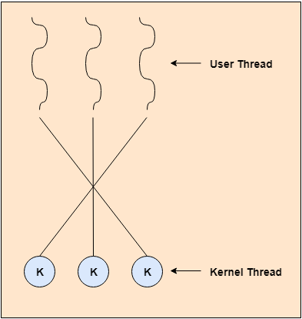
Many to many model
The many to many model maps many of the user threads to a equal or less number kernel threads.
The number of kernel threads maybe specific to either a particular application or particular machine.
Developer can create as many user threads as necessary, and the corresponding kernel threads can run in parallel on a multiprocessor.
Other threads can run when one thread makes a blocking system call.

Slide 24
Process Synchronization
6

Slide 25
Introduction
On the basis of synchronization, processes are categorized as one of the following two types:
Independent Process : Execution of one process does not affects the execution of other processes.
Cooperative Process : Execution of one process affects the execution of other processes.
=> Process synchronization problem arises in the case of Cooperative process also because resources are shared in Cooperative processes.
Pro When more than one processes are executing the same code or accessing the same memory or any shared variable in that condition there is a possibility that the output or the value of the shared variable is wrong

Slide 26
Thanks!
Any questions ?

Slide 27
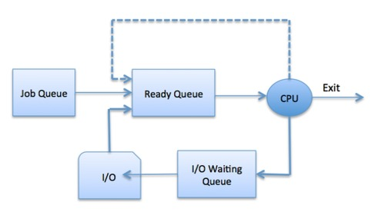
Process Scheduling
The process scheduling is the activity of the process manager which handles the removal of the running process from the CPU and the selection of another process on the basis of a particular strategy.
The Operating System maintains the following important process scheduling queues:
Job queue − This queue keeps all the processes in the system.
Ready queue − This queue keeps a set of all processes residing in main memory, ready and waiting to execute. A new process is always put in this queue.
Device queues − The processes which are blocked due to unavailability of an I/O device constitute this queue.
Notes:
Sửa lại ảnh

